Slide 1
Student Information Management System
Group-1
Sathya Cheeti
Bhanu Prasad Namburi
Veerraju Palacharla

Slide 2
Objectives:
The main objective of this project is to create an efficient database for tracking student performance by storing student results, student course enrollments and few other student details.
It can be used to manage the details of profiles, courses, logins, exams, fees, assignments.
It can also be used to generate a term-wise students’ performance reports.
Using our system we add or edit courses, terms, and new student enrollments.
This project is useful for administrative purposes for getting and storing the results in a simple manner.

Slide 3
Scope
Our database mainly consists of the following tables: Student, student address, Student enrolment, Department,Faculty, Courses, Terms, sections, and Student Financials details.
Our database provides an easy-to-use interface for the students to retrieve information in a timely and reliable manner.
This complete database was built to make administrative tasks easier and more efficient.
The project provides facilities like online registration and profile creation of students thus reducing paperwork and automating the record generation process in an educational institution.

Slide 4
User Requirements:
The database must be able to register new students.
Make changes to the student information.
Look for a specific student or a group of students based on Student ID, department, courses enrolled.
It should add and modify the Term details.
Record the course details and subject information.
Make changes to the course details.
Keep track or modify the student internal grades.
Register a employee or teacher.
It should maintain details student Payments.

Slide 5
Choice of DBMS:
MySQL

Slide 6
Business Rules:
A Student can enroll in multiple Sections.
Each Section can have multiple Students enroll.
Each Faculty is assigned to multiple Sections.
Each Section is assigned to exactly one Faculty person.
A Term can have multiple Courses.
Each Course is belonging to particular Term.
A Student must have one Student Payment Details record.
Each Student Payment Details record belongs to exactly one student.
A Student have one Student Address.

Slide 7
Each Student Address belongs to exactly one record.
A Department can have one or more Faculties.
Each Faculty belongs to only one Department.
Every department can have one or more Students.
Each student belongs to only one Department.
Each Course can have one or more Sections.
Every Section have only one Course.
A Department can offer multiple Courses.
Each Course should belong to exactly one Department

Slide 8
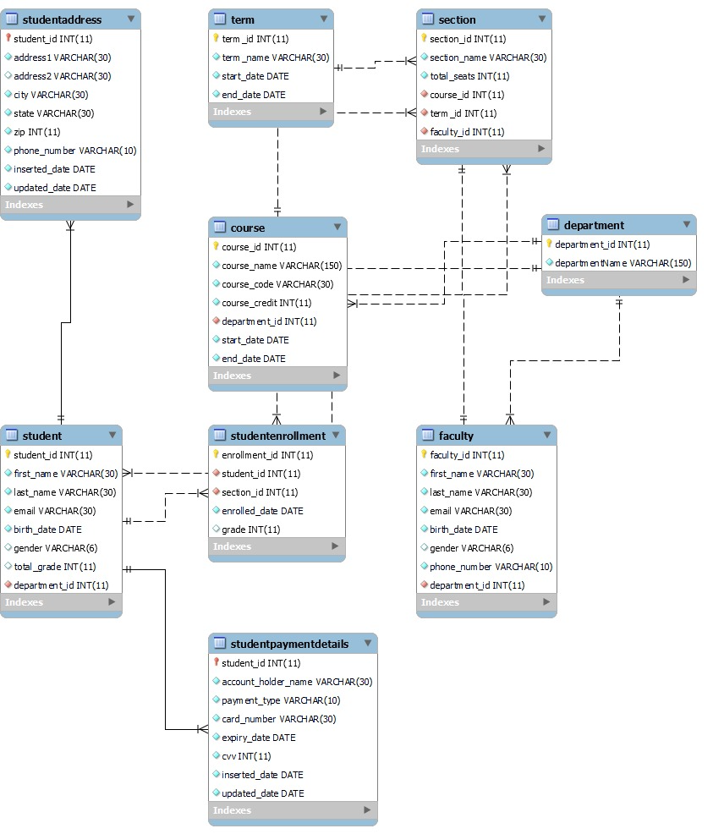
ERD Diagram

Slide 9
Table: Student
Attribute Name | contents | Data types | Format | Range | Required | Pk or fk | Fk required table
student_id | A unique Id assigned to each student | INT | 99999 | 0-99999 | Y | PK
first_name | First name of the student | VARCHAR(30) | XXXXXXX |  | Y
last_name | Last name of the student | VARCHAR(30) | XXXXXXX |  | Y
email | Email of the student | VARCHAR(30) | XXXXXXX |  | Y
birth_date | Date of birth of the student | DATE | yyyy-mm-dd |  | Y
gender | Gender of the student | VARCHAR(6) | xxxxx
total_grade | Total grade of the student | INT | 9
department_id | Department ID of the student | INT | 99999 |  | Y | FK | Department

Slide 10
Student payment detalis
Attribute Name | contents | Data types | Format | Range | Required | Pk or fk | Fk required table
student_id | A unique Id assigned to each student | INT | 99999 | 0-99999 | Y | PK, FK | Student
account_holder_name | Name of the Account holder | VARCHAR(30) | Xxxxxxxxx |  | Y
payment_type | Payment type (credit or debit) | VARCHAR(10) | Xxxxxxxxx |  | Y
card_number | Card number for payment | VARCHAR(30) | Xxxxxxxxx |  | Y
expiry_date | Date of expiry of the card | DATE | yyyy-mm-dd |  | Y
cvv | Cvv number of the card | INT | 999 | 111-999 | Y
inserted_date | Inserted date of the payment detail | DATE | yyyy-mm-dd |  | Y
updated_date | Updated date of the payment detail | DATE | yyyy-mm-dd |  | Y

Slide 11
Table : student Address
Attribute Name | contents | Data types | Format | Range | Required | Pk or fk | Fk required table
student_id | A unique Id assigned to each student | INT | 99999 | 0-99999 | Y | PK, FK | Stduent
address1 | Address line1 of the student | VARCHAR(30) | xxxxxx |  | Y
Address2 | Address line2 of the student | VARCHAR(30) | Xxxxxx
city | City of the student | VARCHAR(30) | xxxxx |  | Y
state | State of the student | VARCHAR(30) | Xxxxx |  | Y
zip | Zip code of the student | INTEGER | 99999 | 0-99999 | Y
phone_number | Phone number of the student | VARCHAR(10) | xxxxxxxx |  | Y
inserted_date | Inserted date of the student detail | DATE | yyyy-mm-dd |  | Y
updated_date | Updated date of the student detail | DATE | yyyy-mm-dd |  | Y

Slide 12
Table : faculty
Attribute Name | contents | Data types | Format | Range | Required | Pk or fk | Fk required table
faculty_id | A unique Id assigned to each faculty | INT | 99999 | 0-99999 | Y | PK
first_name | First name of the faculty | VARCHAR(30) | Xxxxxxxx |  | Y
last_name | Last name of the faculty | VARCHAR(30) | Xxxxxxxxx |  | Y
email | Email of the faculty | VARCHAR(30) | xxxxxxxx |  | Y
birth_date | Date of birth of the faculty | DATE | yyyy-mm-dd
gender | Gender of the faculty | VARCHAR(6) | xxxxxx
phone_number | Phone number of the faculty | VARCHAR(10) | Xxxxxxxxx |  | Y
department_id | Department ID of the faculty | INT | 99999 | 0-99999 | Y | FK | Department

Slide 13
Table:Department
Attribute Name | contents | Data types | Format | Range | Required | Pk or fk | Fk required table
department_id | A unique Id assigned to each Department | INT | 99999 | 0-99999 | Y | PK
department_name | Name of the department | VARCHAR(150) | xxxxxxxx |  | Y

Slide 14
Table: Term
Attribute Name | contents | Data types | Format | Range | Required | Pk or fk | Fk required table
term_id | A unique Id assigned to each Term | INT | 99999 | 0-99999 | Y | PK
term_name | Name of the term | VARCHAR(30) | xxxxxxx |  | Y
start_date | Term Start date | DATE | yyyy-mm-dd |  | Y
end_date | Term End date | DATE | yyyy-mm-dd |  | Y

Slide 15
Table: Course
Attribute Name | contents | Data types | Format | Range | Required | Pk or fk | Fk required table
course_id | A unique Id assigned to each Course | INT | 99999 | 0-99999 | Y | PK
course_name | Name of the Course | VARCHAR(150) | Xxxxxxx |  | Y
course_code | Course code | INT | 99999 | 0-99999 | Y
course_credit | Course credit hours | INT | 9 | 0-4 | Y
department_id | Department to which course belongs | INT | 99999 | 0-99999 | Y | FK | Department
term_id | Term id of the course | INT | 99999 | 0-99999 | Y | FK | Term
start_date | Course start date | DATE | yyyy-mm-dd |  | Y
end_date | Course end date | DATE | yyyy-mm-dd |  | Y

Slide 16
Table: section
Attribute Name | contents | Data types | Format | Range | Required | Pk or fk | Fk required table
section_id | A unique Id assigned to each section | INT | 99999 | 0-99999 | Y | PK
section_name | Name of the section | VARCHAR(30) | Xxxxxx |  | Y
total_seats | Total number of seats | INT | 999 | 0-999 | Y
course_id | Course id of the section | INT | 99999 | 0-99999 | Y | FK | Course
faculty_id | Faculty id assign to the section | INT | 99999 | 0-99999 | Y | FK | Faculty

Slide 17
Table: student enrollment
Attribute Name | contents | Data types | Format | Range | Required | Pk or fk | Fk required table
enrollment_id | A unique Id assigned for each enrollment | INT | 99999 | 0-99999 | Y | PK
student_id | Student Id of the enrollment | INT | 99999 | 0-99999 | Y | FK | Student
section_id | Section Id of the enrollment | INT | 99999 | 0-99999 | Y | FK | Section
enrolled_date | Enrollment date | DATE | yyyy-mm-dd |  | Y
grade | Grade of the student for the course enrolled | INT | 9 | 0-4

Slide 18
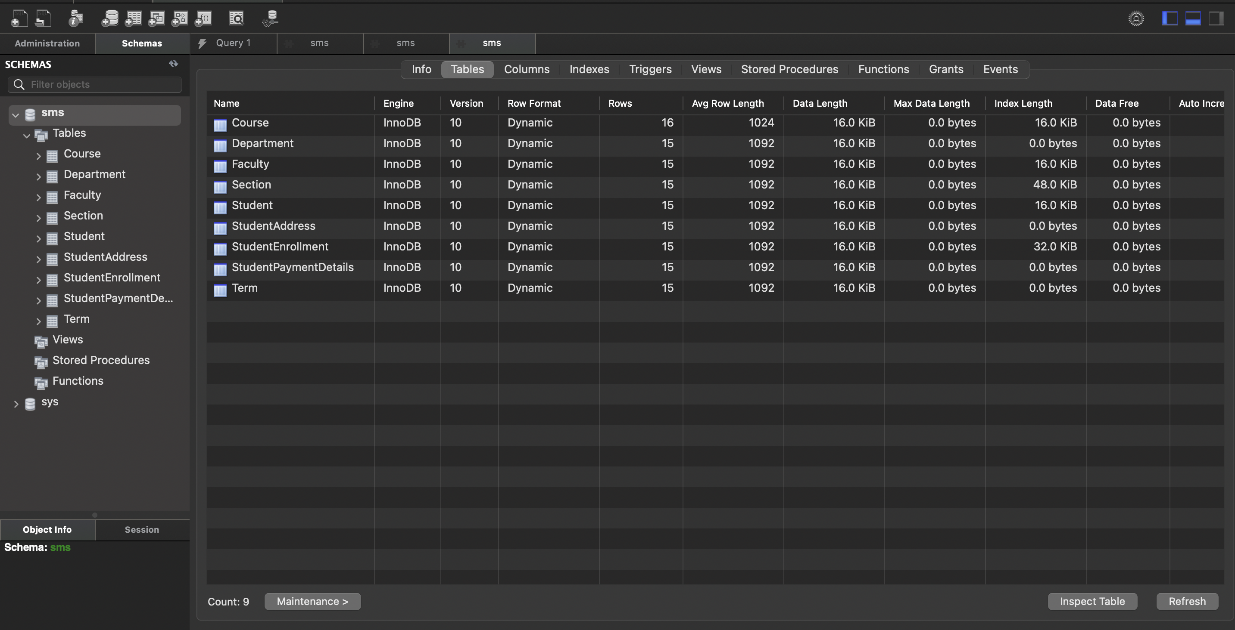
Database in Dbms

Slide 19
Data Retrieval and sample records

Slide 20
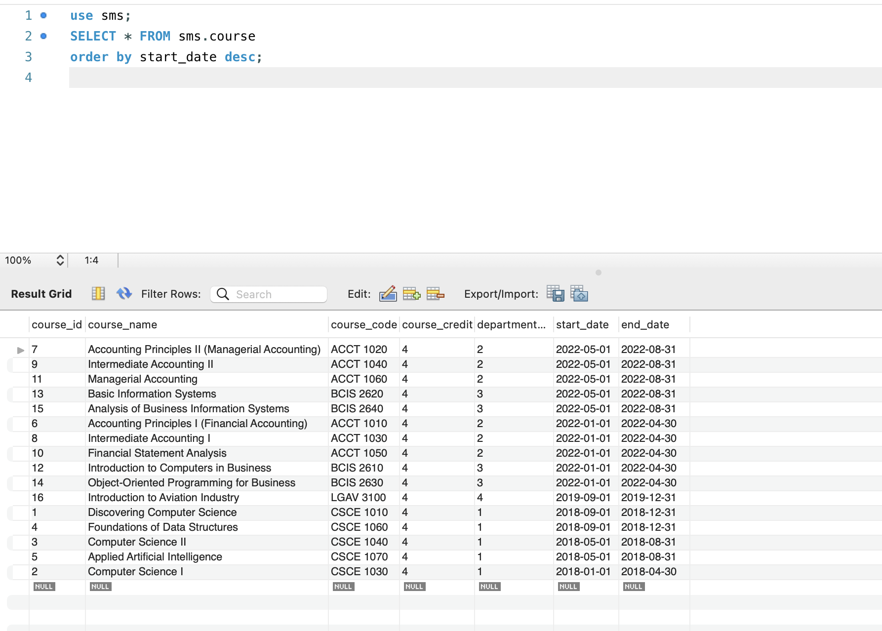
Display all the course details sorted by their startdate
Use sms; SELECT * FROM sms.course order by start_date desc;

Slide 21
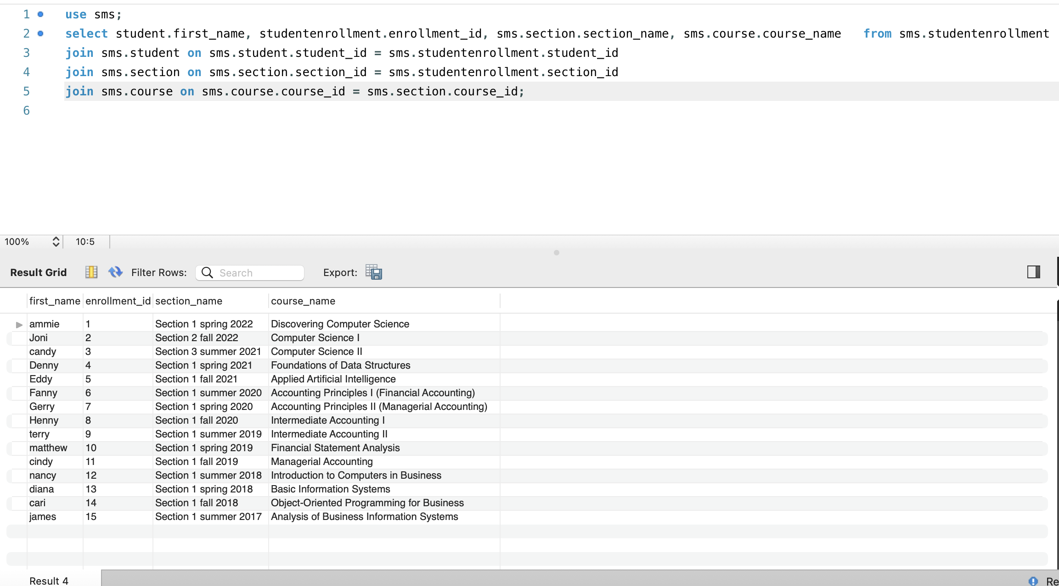
Display all the student enrollment details with the student first name , enrolled course and the section name.
select student.first_name, studentenrollment.enrollment_id, sms.section.section_name, sms.course.course_name from studentdatabase.studentenrollment join sms.student on sms.student.student_id = sms.studentenrollment.student_id join sms.section on sms.section.section_id = sms.studentenrollment.section_id Join sms.course on sms.course.course_id = sms.section.course_id;

Slide 22
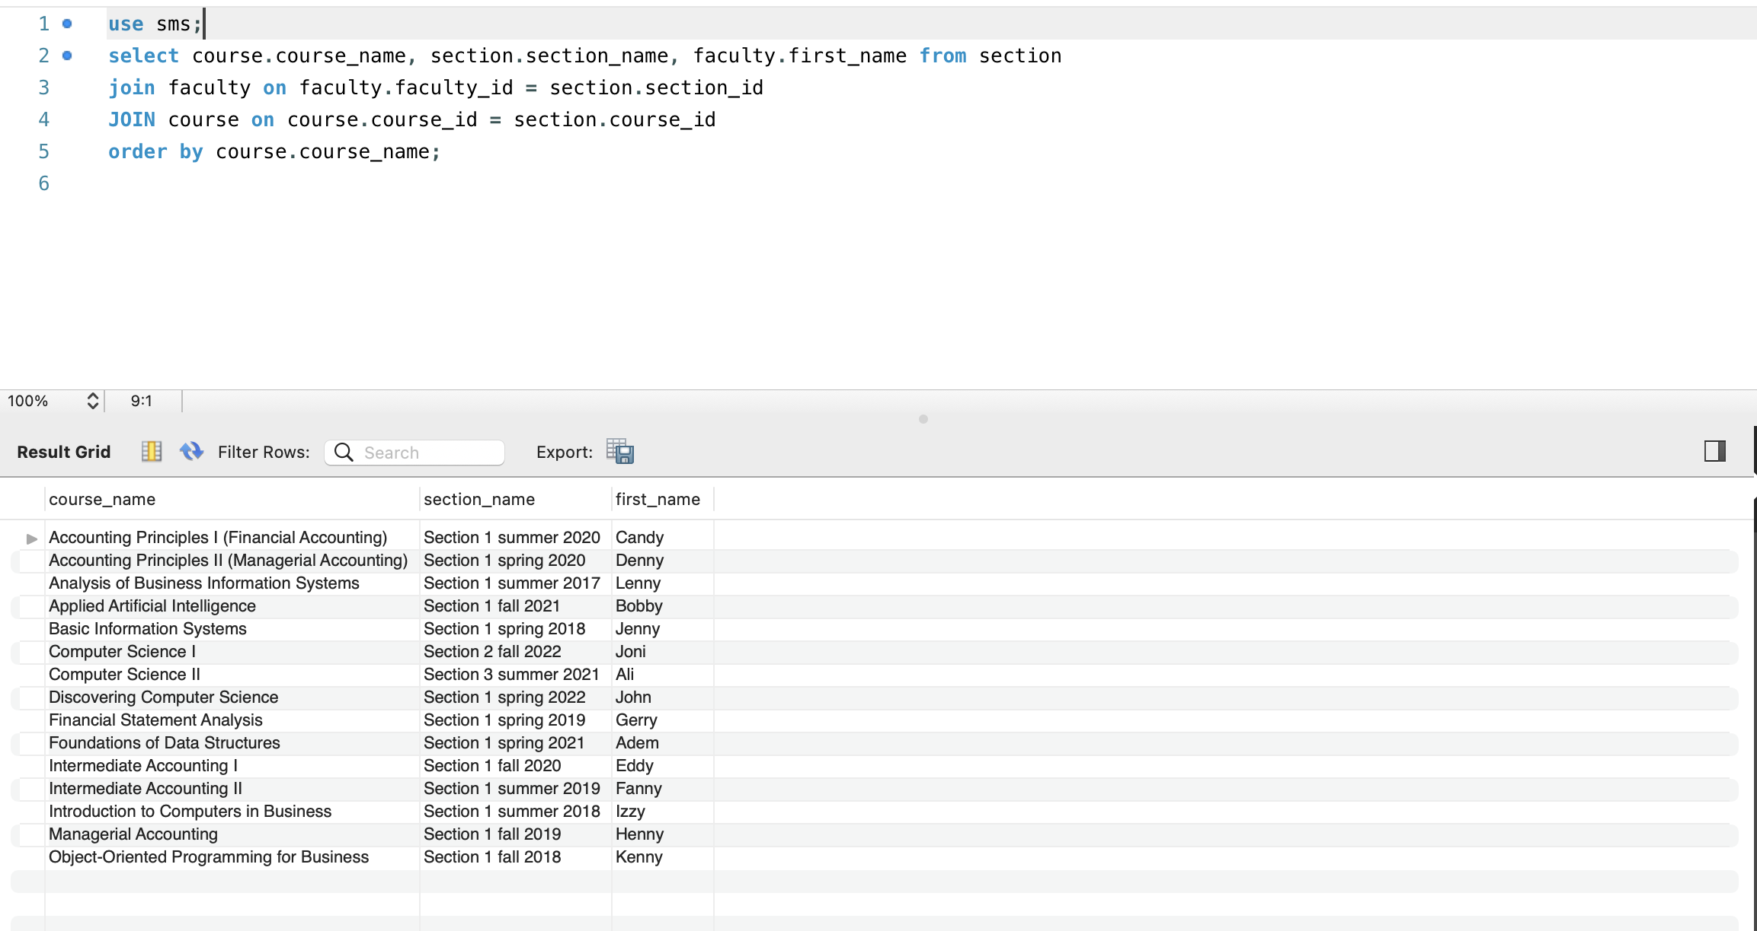
Show all the section details including faculty name and course name sort by course name
select course.course_name, section.section_name, faculty.first_name from section
join faculty on faculty.faculty_id = section.section_id
JOIN course on course.course_id = section.course_id order by course.course_name;

Slide 23
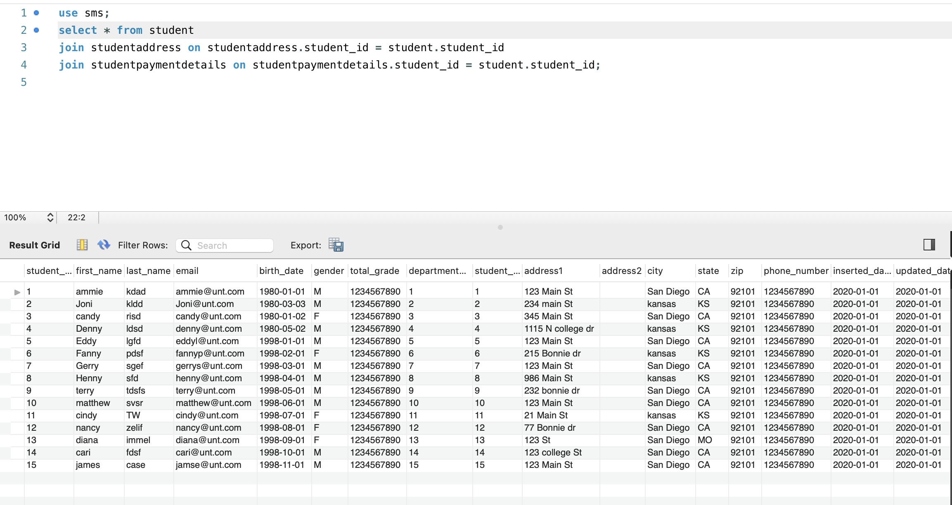
Display all the student details including student name, address, payment details, and section details
select * from student join studentaddress on studentaddress.student_id = student.student_id join studentpaymentdetails on studentpaymentdetails.student_id = student.student_id;

Slide 24
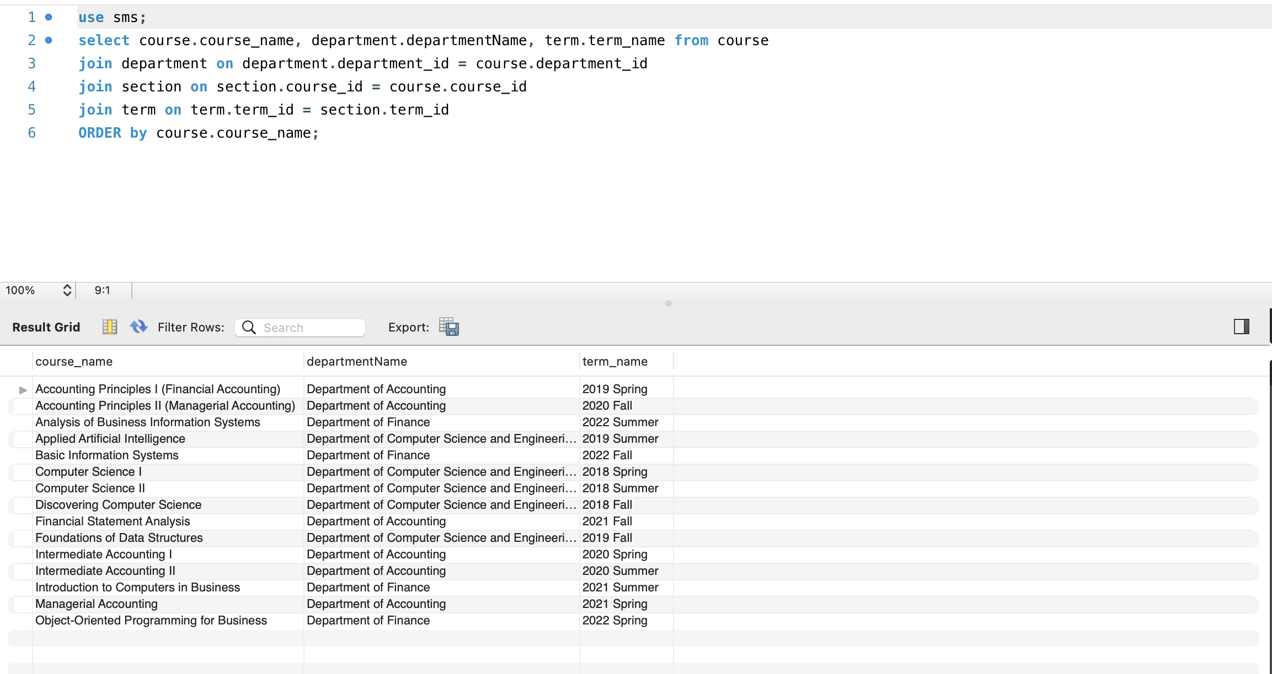
Show all courses details along with the department name and term sort by course name
select course.course_name, department.departmentName, term.term_name from course join department on department.department_id = course.department_id join section on section.course_id = course.course_id join term on term.term_id = section.term_id
ORDER by course.course_name;

Slide 25
Thank you

